Slide 1


Join at slido.com #3436682
ⓘ Start presenting to display the joining instructions on this slide.
Notes:
Bradley:
Hi Everyone – before we begin can you please take out your cell phones and use the QR code to log into Slido. We have a bit of an interactive session coming. I will give you 20 seconds to do this.

Slide 2

Clearing the Air: Unveiling Insights on Pollution and Health Through Data Analysis
Notes:
Group 5's project was created by Wendy Ware, Bradley Cuthoys, Fatima Girnay, and Alvin Giang.
In this presentation we will be ‘Clearing the Air’ and unveiling insights on pollution and its impact on health and wellbeing.

Slide 3
THE Process
Data and Process
Notes:
Bradley:
Drawing data from a wide range of sources, we each chose a more specific hypothesis related to air pollution that was important and exciting to us. Our sources included everything from OpenWeatherMap Air Pollution API to the World Health Organization's Global Air Quality Database.

Slide 4
OpenWeatherMap Air Pollution API
Global Health Data Exchange
Australian Bureau of Statistics (2021) Regional Population
API NINJAS
Kaggle: cause of death
Kaggle: air pollution
Study Objective:
Analyse key air pollution metrics at varying scales and over different timeframes to evaluate impact on public health and wellbeing.
Collation
Cleaning
2
Data Preparation
Descriptive Stats
1
Define
3
Exploratory Data Analysis
Graphical Stats
Input: Hypothesis
6
Review &
Feedback
4
Interpretation & Validation
5
Conclusions
Output: Reporting
Notes:
Bradley:
For the duration of the project, we followed the analytical process displayed on the screen now; we defined our hypotheses, collated and cleaned our data, performed exploratory analyses, interpreted our findings and drew conclusions, and finally held a group meeting for the purposes of review and feedback.

Slide 5

 |  | SO₂ | NO₂ | PM₁₀ | PM_{2.5} | O₃ | CO
 |  | Concentration in μg/m³
Good | 1 | [0; 20) | [0; 40) | [0; 20) | [0; 10) | [0; 60) | [0; 4400)
Fair | 2 | [20; 80) | [40; 70) | [20; 50) | [10; 25) | [60; 100) | [4400; 9400)
Moderate | 3 | [80; 250) | [70; 150) | [50; 100) | [25; 50) | [100; 140) | [9400-12400)
Poor | 4 | [250; 350) | [150; 200) | [100; 200) | [50; 75) | [140; 180) | [12400; 15400)
Very Poor | 5 | ⩾350 | ⩾200 | ⩾200 | ⩾75 | ⩾180 | ⩾15400
Not included in the Air Quality Index: Nitrogen monoxide (NO) and Ammonia (NH₃)
Pollutants
Notes:
Bradley:
During our presentation, you will see the symbol for the greek letter mu, followed by a slash m3. Mu,or "Micro" is a prefix in the metric system meaning 10 to the -6 power: 1 millionth of a gram. This is how the various elements of air pollutants are measured. In general, the higher the micrograms per cubic meter, the more detrimental the effects on humans will be.
Special thank you to our team captain Wendy Ware for doing a phenomenal job in organizing our team and keeping us on track to complete this project. Please enjoy the presentation.

Slide 6

LET’S HAVE SOME FUN
HYPOTHESES Q&A
Notes:
Alvin:
Good evening, everyone, now we are going to play a fun game. In this game, we are giving you 5 hypotheses or statements about air pollution, and you are going to guess if that hypothesis is true or false.
So, get your phone’s ready – let’s have some fun!

Slide 7

The greater the population size, the higher the recorded pollution in a town or city.
ⓘ Start presenting to display the poll results on this slide.
Notes:
Alvin:
Our first statement is ‘The greater the population size, the higher the recorded pollution in a town or city.’ On your mobiles, select whether you think this statement is true or false.

Slide 8

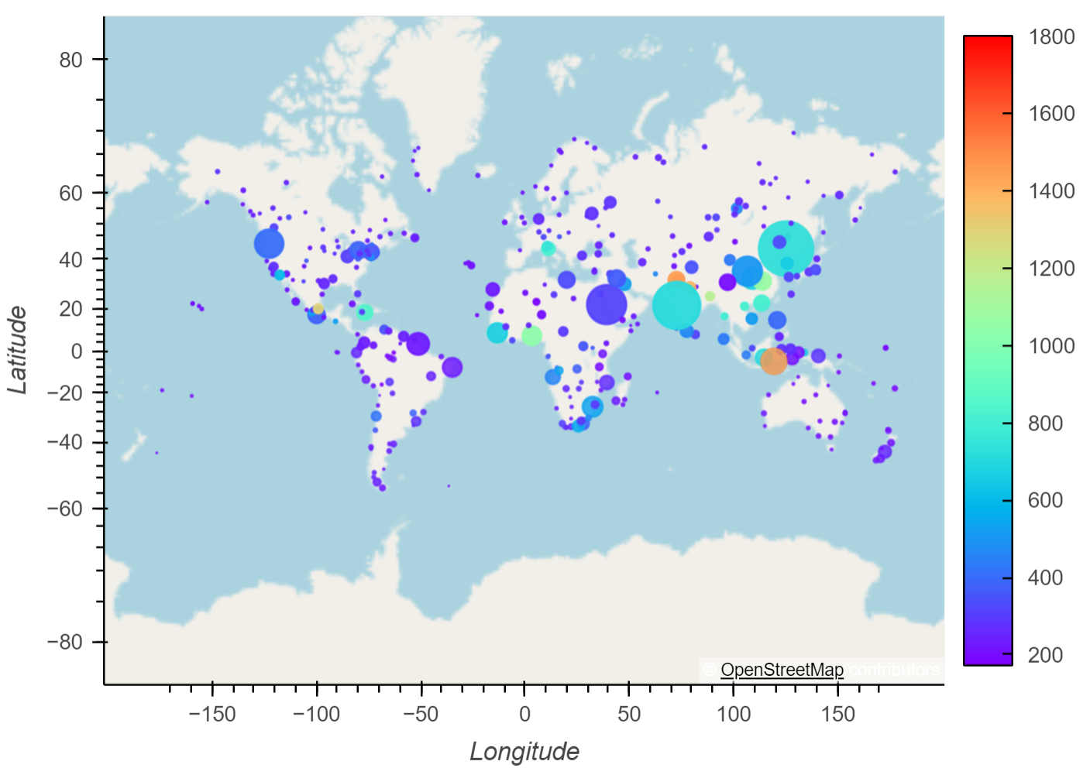
Global Winter CO Pollution Levels in μg/m by Population
Q&A - Population versus Pollution - Global
Notes:
Alvin:
Global Pollution Map: This map shows higher concentrations of pollution (represented by warmer colours) corresponding with larger population areas (denoted by bubble size). This visual correlation supports the hypothesis that more populous areas tend to have higher pollution levels.

Slide 9
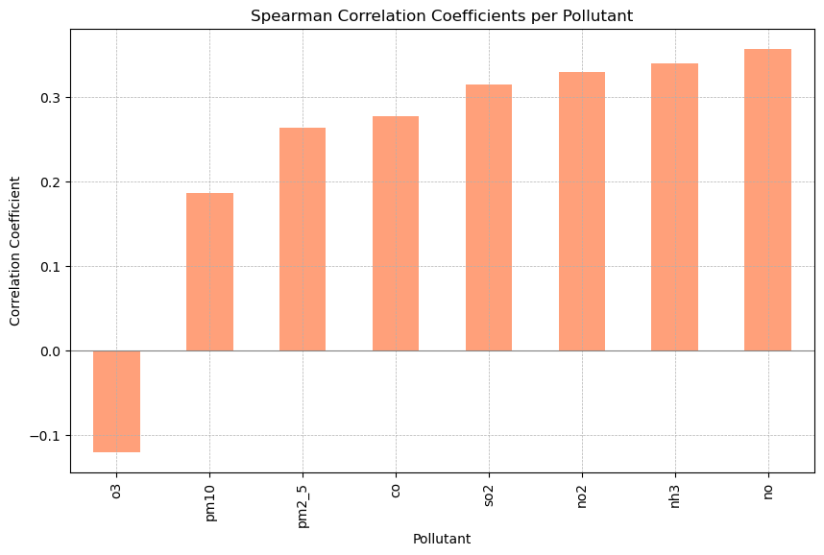
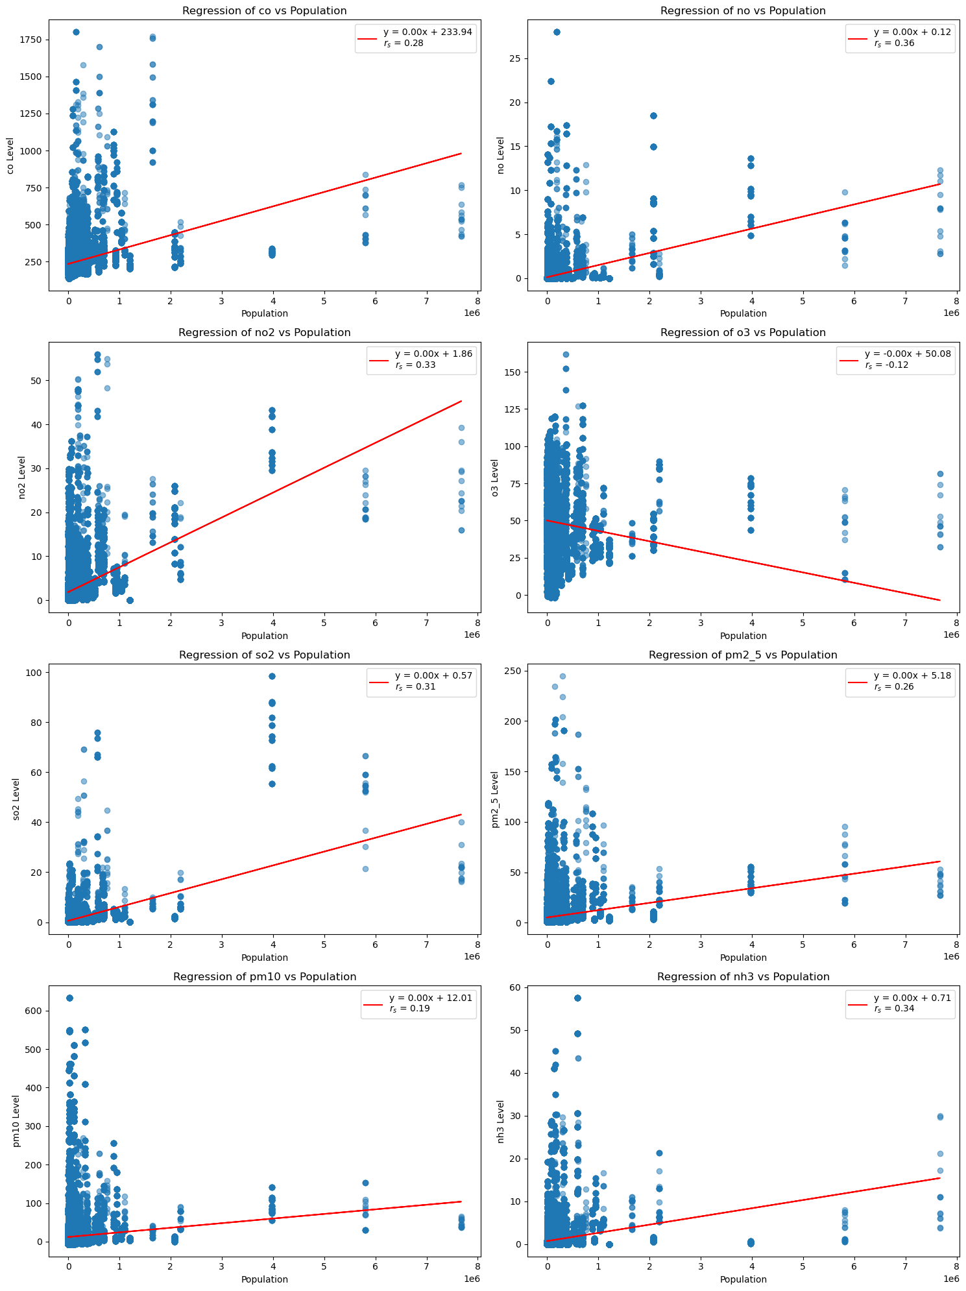
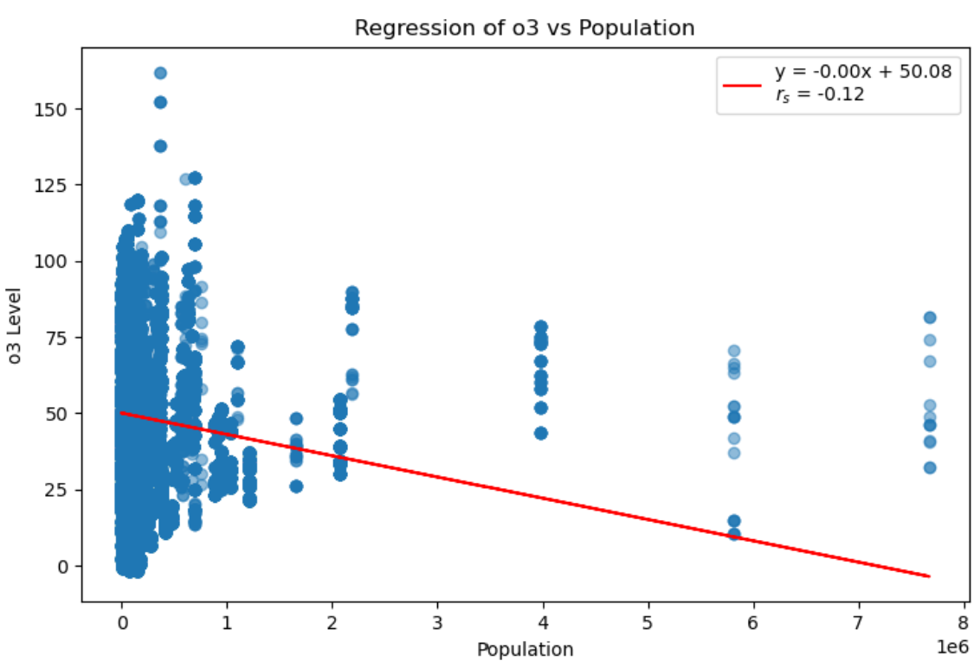
Nitrogen Monoxide
Ozone
Q&A - Population versus Pollution - Global
Notes:
Alvin:
Spearman Correlation Coefficients: The bar graph shows a negative correlation for ozone with population (𝑟𝑠=−0.12) and positive correlations for other pollutants. This suggests that except for ozone, higher population sizes generally correlate with increased pollution levels, supporting the hypothesis.

Slide 10
Higher population densities are associated with higher air pollution levels in Australian towns and cities.
ⓘ Start presenting to display the poll results on this slide.
Notes:
Alvin:
Now we are going from global scale to country scale – in this example we are looking at Australia.
Our second statement is ‘Higher population densities are associated with higher air pollution levels in Australian towns and cities.’
Do you think this hypothesis is true or false?

Slide 11

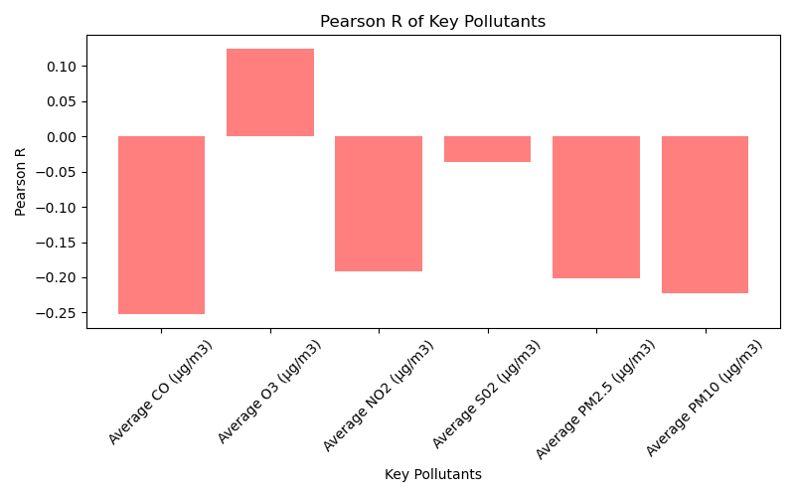
Q&A - Population versus Pollution – Local (Australia)
Notes:
Alvin:
As you can see in the bar chart, the correlation coefficient between the population densities and the levels of key pollutants falls within the range of -0.3 to 0.1, showing a weak relationship between these two variables.
This suggests that changes in population density in Australia are not strongly associated with changes in the air pollution levels.
In conclusion, while population size is an important factor in understanding air quality, the study suggests that other variables may play a significant role in influencing pollution levels.
Further research and exploration of additional factors are needed to gain a comprehensive understanding of the complex dynamics that contribute to air pollution.

Slide 12
Globally pollutant levels vary significantly across the four season.
ⓘ Start presenting to display the poll results on this slide.
Notes:
Wendy:
Okay – so let’s look at another variable….seasons….
Our third statement is ‘Globally pollutant levels vary significantly across the four season.’
What do you think? Is this true of false?

Slide 13
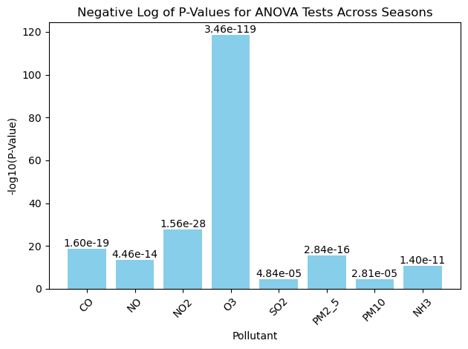
Q&A - Pollutant Levels By Season
Notes:
Wendy:
ANOVA Results: Strong statistical evidence shows significant variation in global pollutant level means across the seasons. The most pronounced differences are observed in Ozone, with p-values indicating highly significant seasonal changes.

Slide 14

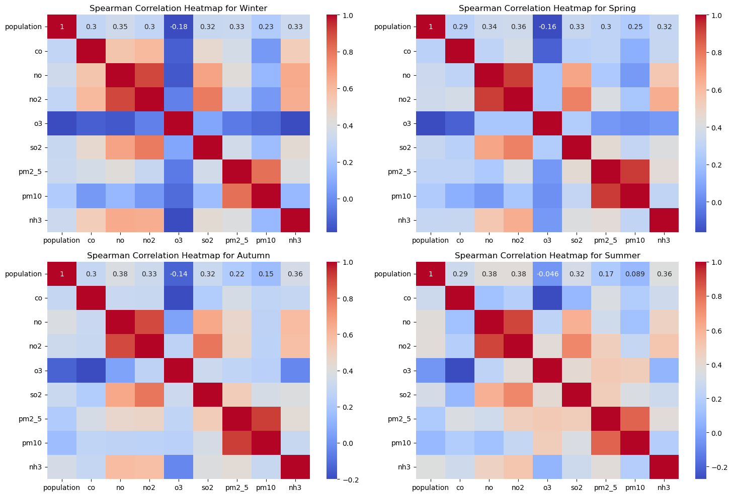
Autumn
Winter
Summer
Spring
Q&A - Pollutant Levels By Season
Notes:
Wendy:
Seasonal Correlation Heatmaps: Distinct seasonal patterns are visible in pollutant levels, with varying correlations between pollutants and seasons. Notably, ozone show strong seasonal fluctuations, illustrating their sensitivity to seasonal changes.

Slide 15
Higher levels of air pollutants correlate with higher occurrences of depressive disorders.
ⓘ Start presenting to display the poll results on this slide.
Notes:
Bradley:
The subject of air pollution and its impact on mental health disorders is one that has been given much attention in recent years. Many types of pollutants can have negative effects on health, but one of the most insidious is particulate matter.
There are two types of particulate matter:
- PM10: Coarse particles, 10 microns or less in diameter that can irritate your eyes, nose, and throat. Dust from roads, farms, dry riverbeds, construction sites, and mines are types of PM10.
- PM2.5: Fine particles, 2.5 microns or less in diameter, are more dangerous because they can get into the deep parts of your lungs — or even into your blood.

Slide 16
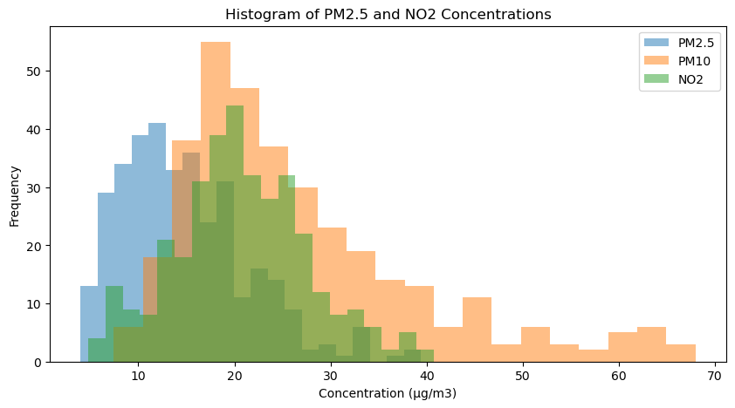
Histograms for PM2.5, PM10 and NO2
Q&A – Pollution Versus Depression
Notes:
Bradley:
This question of correlation was tested through a quantitative method of inquiry. The air quality data was gathered from the World Health Organization's Ambient Air Quality Database, compiling annual mean concentrations of PM2.5, PM10, and NO2 for 600 settlements in over 100 countries. While some countries reported numbers as far back as 2000, most of the data collected was from the period between 2011 and 2019. The population and prevalence of depressive disorders data was collected from the Institute for Health Metrics and Evaluation's Global Burden of Disease Study 2019. The GBD study utilized compiled data from 204 countries, territories and selected subnational locations.
The analysis was performed using both descriptive and inferential statistics. Data sets collected were examined for normal distribution, and any outliers were eliminated. The final analysis was conducted with a series of 10 countries over a period of 10 years, from 2010-2019.

Slide 17

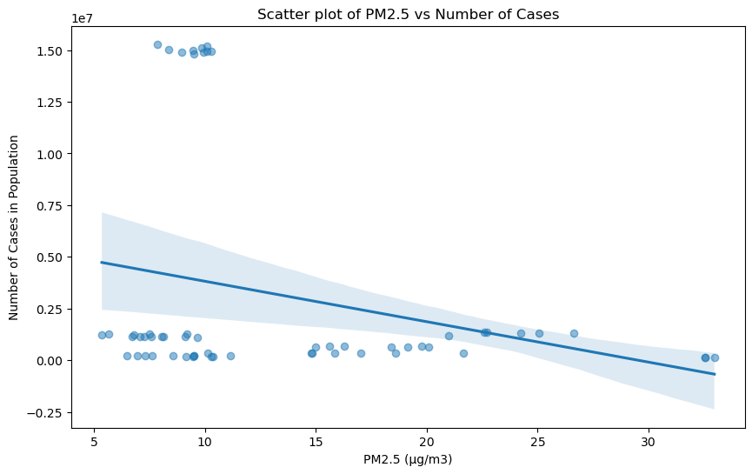
Correlation Coefficient: -0.26
Q&A – Pollution Versus Depression
Notes:
Bradley:
Data included the concentration of PM2.5, PM10, and NO2, measured in the micrograms (one-millionth of a gram) per cubic meter. The skewness of that data was as follows: PM2.5 = 1.23, PM10 = 0.91, and NO2 = 0.67. The data for prevalence of depressive mental disorders per country per year was measured as the number of cases reported in the location's population, and percent prevalence was calculated. The skewness was as follows: Number of Cases: 1.76, and Percent Prevalence: -0.34.
The countries with the highest concentration of air pollution were Mongolia, China and Bangladesh. The countries with the lowest concentration of air pollution were Estonia, Finland, and Iceland.
As PM2.5 is considered the most dangerous particle in terms of detrimental health effects, this element was focused on for the purposes of considering correlation between depressive disorders and air pollution. The scatter plot for the data indicated that the correlation coefficient between the elements of air pollution and depressive disorders was -0.26, meaning there's a slight tendency for one variable to decrease when the other increases, but this relationship is not very strong. Within the dataset at hand, the results are at best inconclusive - a more detailed study of country-specific locations would be recommended.

Slide 18
Which air pollutant has the most significant correlation to respiratory deaths?
ⓘ Start presenting to display the poll results on this slide.
Notes:
Fatema:
For our last statement, we hypothesized that air pollution is positively correlated to respiratory deaths. Our question for you is: Which pollutant is most significantly correlated with respiratory deaths?

Slide 19

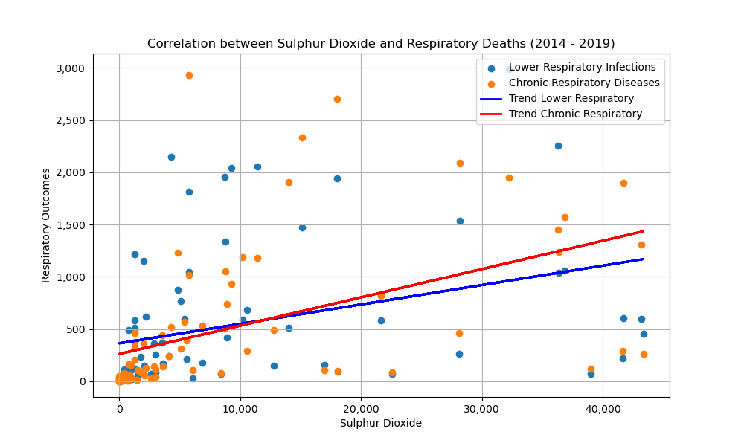
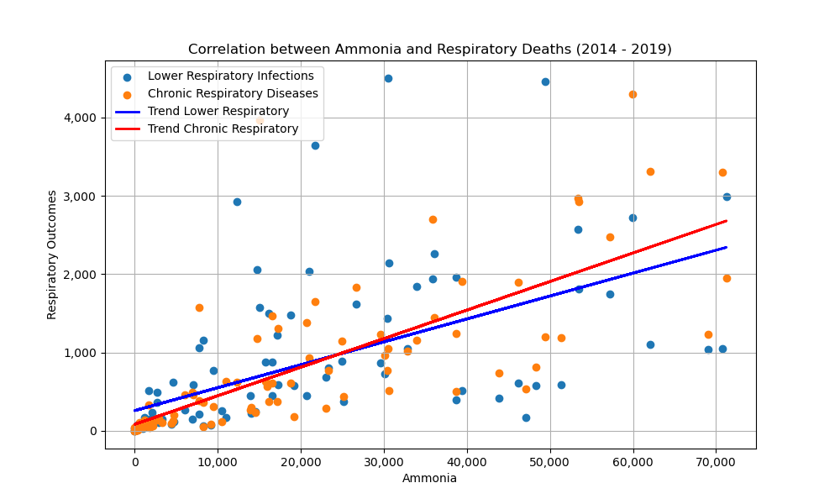
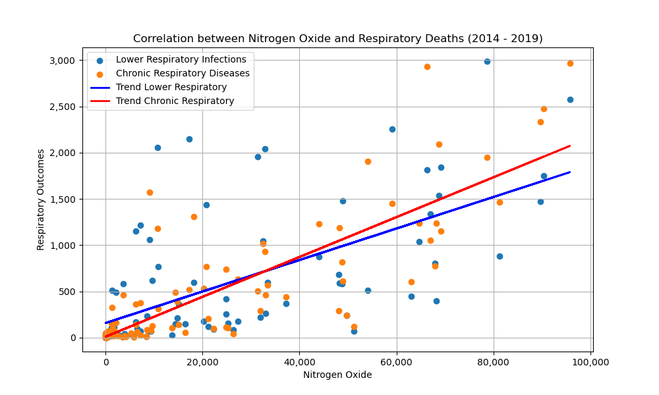
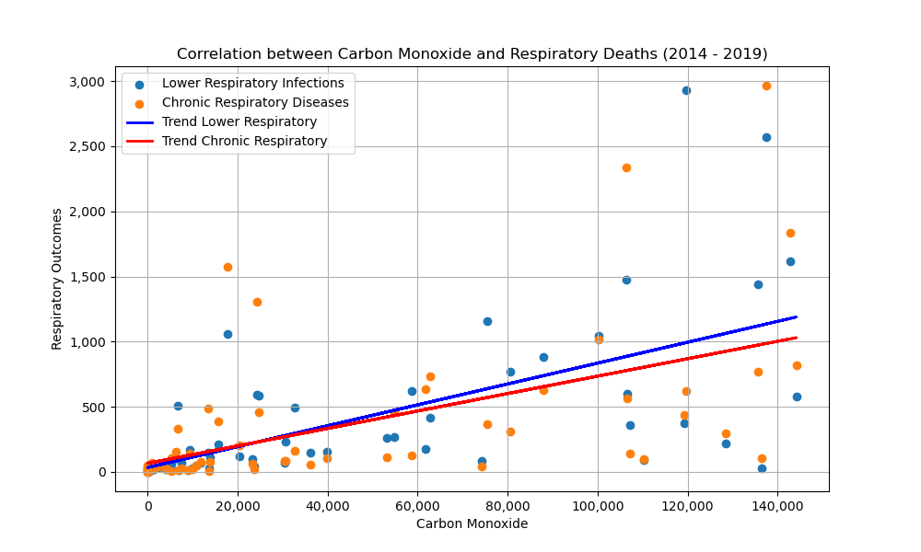
Sulphur Dioxide
Ammonia
Nitrogen Monoxide
Carbon Monoxide
Q&A – Pollution Versus Respiratory Health
Notes:
Fatema:
To examine the relationship between sulphur dioxide, nitrogen oxide, carbon monoxide, ammonia, and the incidence of deaths from lower respiratory infections and chronic respiratory diseases, we analysed air pollution data from each country and compared it to the respective respiratory mortality rates.
Our findings indicate a positive correlation between both respiratory outcomes and each air pollutant. The average correlation coefficient across all four pollutants for chronic respiratory deaths over a six-year period was 0.902, and for lower respiratory infections, it was 0.670, underscoring the significant association between air pollution and respiratory health.
Particularly noteworthy is the discovery that among these pollutants, ammonia exhibits a notably higher correlation coefficient with lower respiratory deaths compared to the other three pollutants. In fact, the average correlation coefficient for ammonia over the six-year period is 0.822, while the average for the other three pollutants combined is 0.646. Showing that ammonia has a significantly higher impact on our respiratory health.

Slide 20
CONCLUSIONS
So, What are Our Thoughts?
Notes:
In conclusion, while our study reveals varying degree of correlation between air pollution, population density, mental health disorders and respiratory outcomes it emphasized the urgent need for targeted research and intervention to mitigate the adverse effects of pollution on huma health, particularly respiratory health and to address the nuanced relationships between pollution, population dynamics, and mental health wellbeing.

Slide 21
Conclusion
Limitations
1
Population v Pollution Levels
=
Correlation (Global)
≠
Weak Correlation (Australia)
Timeframe (2 years)
Socio-economic considerations
2
Pollution Level Means Vary by Season
Timeframes (2 years)
Consistency of reporting and analysis across countries
Conclusions & Limitations
Notes:
In conclusion, while our study reveals varying degrees of correlation between air pollution, population density, mental health disorders and respiratory outcomes it emphasised the urgent need for targeted research and intervention to mitigate the adverse effects of pollution on human health, particularly respiratory health and to address the nuanced relationships between pollution, population dynamics, and mental health wellbeing.

Slide 22
Conclusion
Limitations
3
Air Pollution v Depressive Mental Health Disorders
=
Inconclusive (more study needed)
Data collection bias
Consistency of reporting
4
Air Pollution v Respiratory Deaths
=
Significant Correlation
Ecological fallacy
Correlation ≠ Causation
Conclusions & Limitations
Notes:
In conclusion, while our study reveals varying degrees of correlation between air pollution, population density, mental health disorders and respiratory outcomes it emphasised the urgent need for targeted research and intervention to mitigate the adverse effects of pollution on human health, particularly respiratory health and to address the nuanced relationships between pollution, population dynamics, and mental health wellbeing.

Slide 23

QUESTIONS?

